Slide 1
DevOps Industrial Training

Slide 2

Ansible

Slide 3
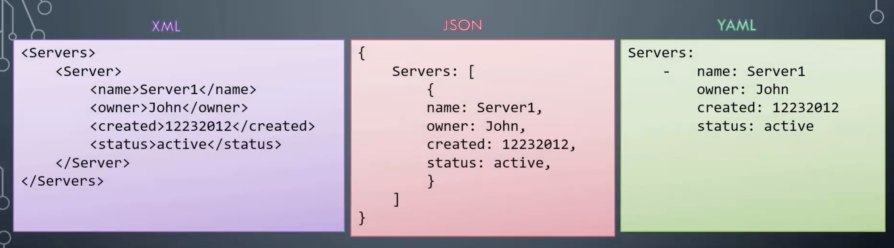
YAML

Slide 4
Servers:
- name: john
owner: jkjf
- name: gunjan
owner:
Cars:
- name: ford
owner: jkfjf
- name: bmw
owner: foo

Slide 5
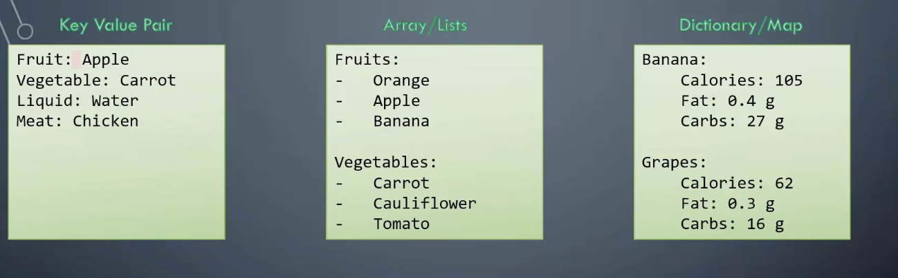
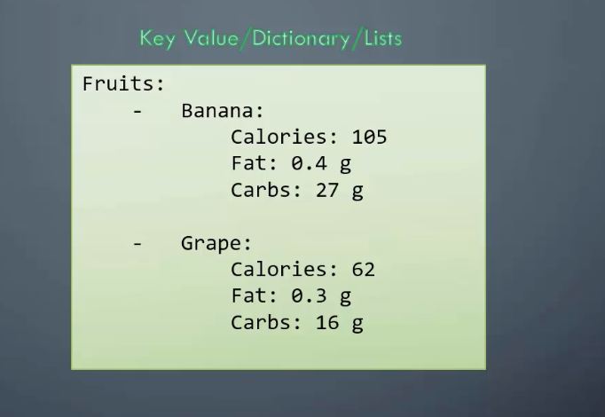

Slide 6
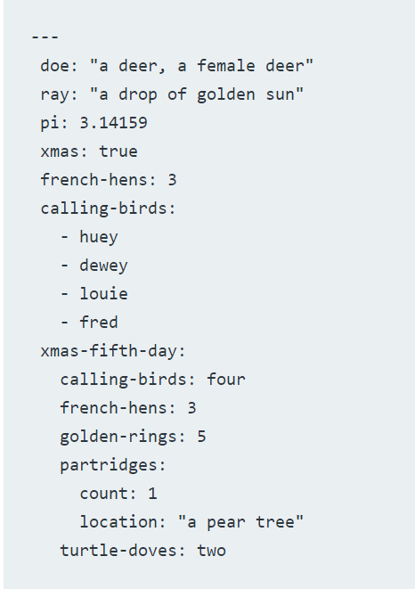
yaml/yml
The file starts with three dashes.
These dashes indicate the start of a new YAML document.
YAML supports multiple documents, and compliant parsers will recognize each set of dashes as the beginning of a new one.
Next, we see the construct that makes up most of a typical YAML document: a key-value pair.
Doe is a key that points to a string value: a deer, a female deer. YAML supports more than just string values.
The file starts with six key-value pairs. They have four different data types.
Doe and ray are strings.
Pi is a floating-point number.
Xmas is a boolean.
French-hens is an integer.
You can enclose strings in single or double-quotes or no quotes at all. YAML recognizes unquoted numerals as integers or floating point. The seventh item is an array.
Calling-birds has four elements, each denoted by an opening dash. I indented the elements in calling-birds with two spaces. Indentation is how YAML denotes nesting. The number of spaces can vary from file to file, but tabs are not allowed.
Finally, we see xmas-fifth-day, which has five more elements inside it, each of them indented.
We can view xmas-fifth-day as a dictionary that contains two string, two integers, and another dictionary.

Slide 7
Ansible Playbooks
Ansible Playbooks are Ansible’s Orchestration language
Define what we want Ansible to do
Set of Instructions to tell Ansible what to do
Ansible are written in yaml (yet another markup language) format
Playbook – A single Yaml file
Play: Defines a set of activities (tasks) to be run on hosts
Task: An Action to be performed on the host
> Execute a command
> Run a Script
> Install a package
> shutdown/restart

Slide 8
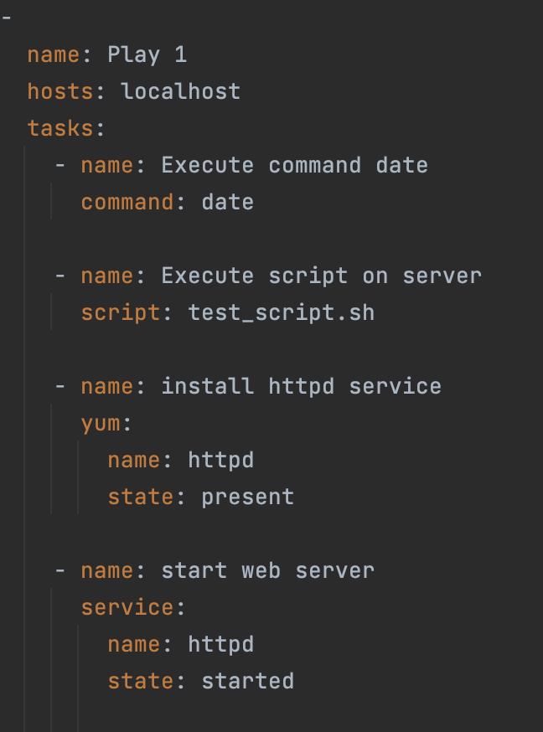
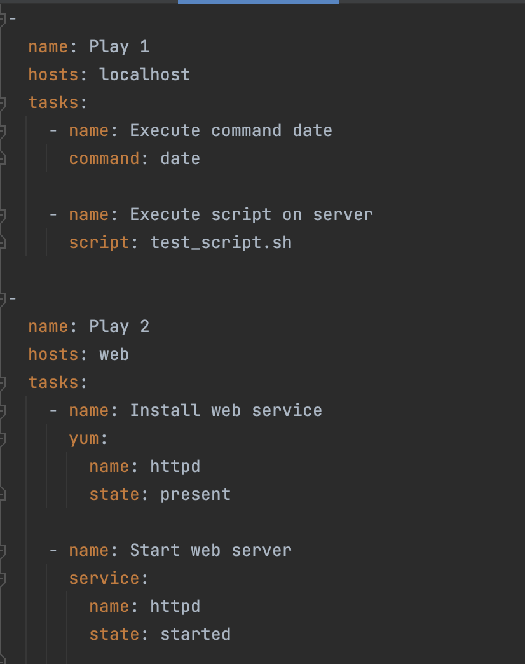

Slide 9
Run Playbooks
To run Ansible playbooks the command is –
Syntax : ansible-playbook <playbookname>
ansible-playbook playbook.yaml
ansible-playbook playbook.yaml -i inventory
ansible-playbook --help
To run Ad-hoc the command is –
Syntax : ansible <collection> -m <module> -i <inventory>
ansible --help

Slide 10
Ansible Modules
System :
User
Group
Hostname
Iptable
Make
Mount
Ping
Timezone
Systemd
Service
Command :
Command
Expect
Raw
Script
Shell
File :
Acl
Archive
Unarchive
Copy
File
Find
Lineinfile
Replace
Stat
Template
Database :
MongoDB
Mssql
Postgreswl
Proxysql
vertica
Cloud :
Amazon
Atomic
Azure
Digital Ocean
Docker
Google
Openstack
VMWare
Smartos
Windows :
Win_copy
Win_command
Win_domain
Win_file
Win_ping
Win_package
Wind_service
Win_user

Slide 11
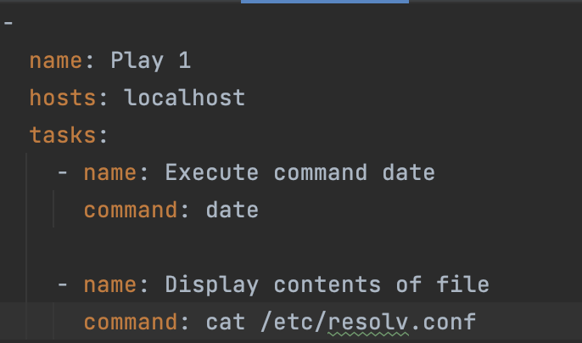
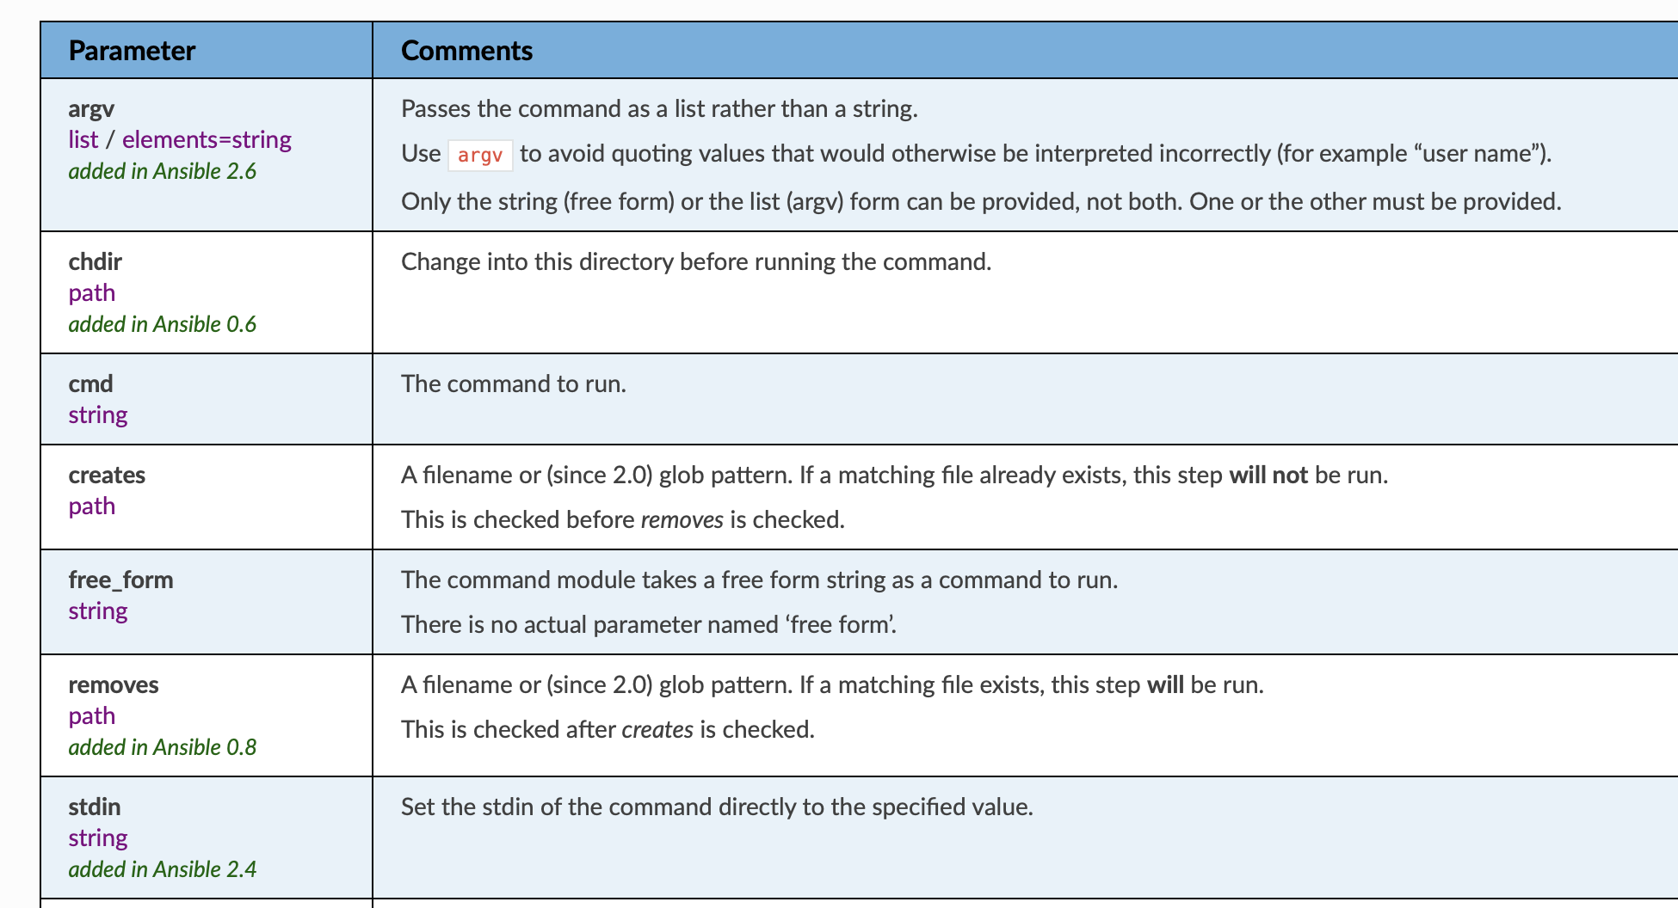
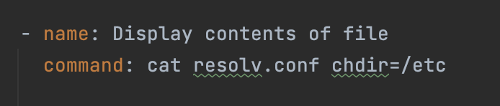
Command Module
Executes command on a remote node

Slide 12
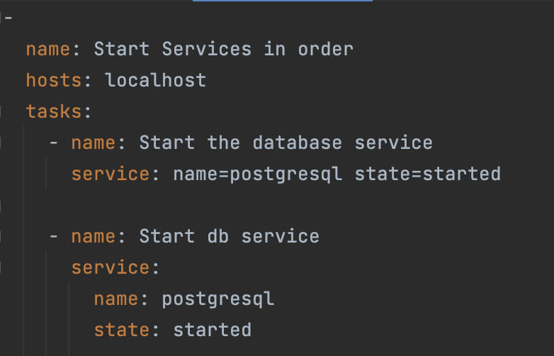
Service Module
Manage services – Start, Stop, Restart

Slide 13
Idempotency
Why “started” and not “start” ??
We are instructing Ansible to – Ensure service httpd is started
If httpd is not already started => start it
If httpd is already started => do nothing
Ansible is a declarative state engine at its core. Through tasks, playbooks describe the state to which the system is to be configured. The logic behind the modules run by the playbook tasks works to achieve the specified state.
A key principle of Ansible that makes it different from scripting is the concept of idempotency. The official Ansible documentation describes idempotency as follows:
“An operation is idempotent if the result of performing it once is exactly the same as the result of performing it repeatedly without any intervening actions.”
This means that if you run a playbook with the same set of inputs, you should not expect it to make any changes on the system.

Slide 14
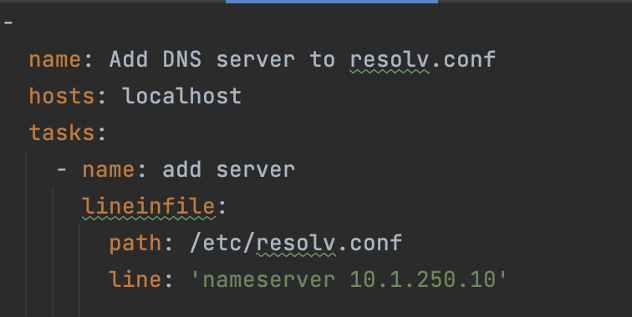
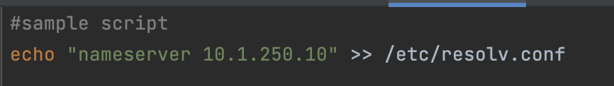
lineinfile Module
Search for a line in a file and replace it or add if it doesn’t exist
Idempotent
Non Idempotent

Slide 15
Things to know about Modules
Also referred as task plugins or library plugins
Default location for Ansible modules is /usr/share/ansible
Take arguments in key=value format (state=stopped)
Returns data in JSON format
Modules should be idempotent, meaning they should not do any changes if current state of system matches with the desired final state
To access list of all installed modules using command line: ansible-doc -l
To see the documentation of particular module using command line: ansible-doc yum where yum is the module name
You can run modules from the command line or include them in Playbook

Slide 16
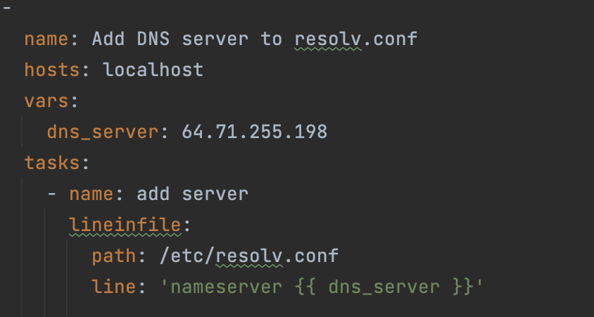


Ansible Variables
Stores information that varies with each host
{{ }}
Jinja2 Templating
source: {{ ip_Address }}
source: ‘{{ ip_address }}’
source: something {{ ip_address }} something

Slide 17
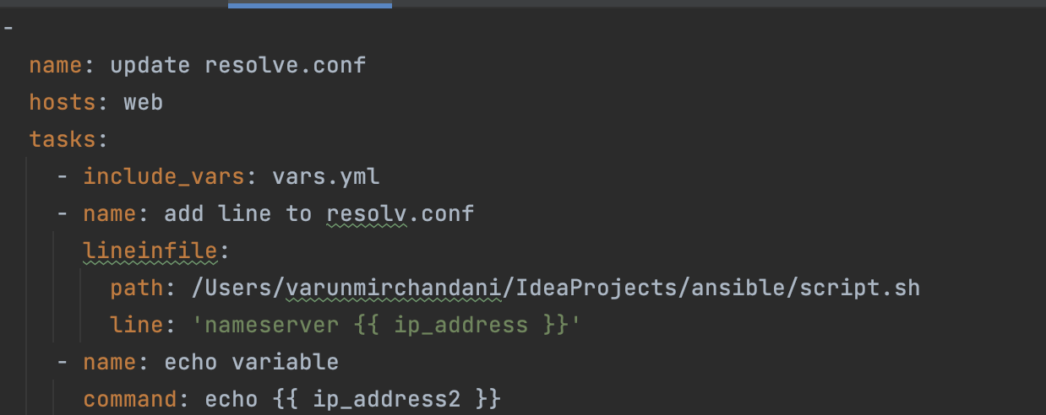
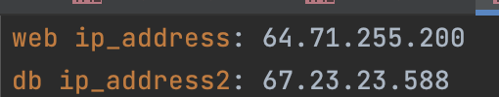
Ansible Variables
You can use an external file for defining variables and include in playbook

Slide 18
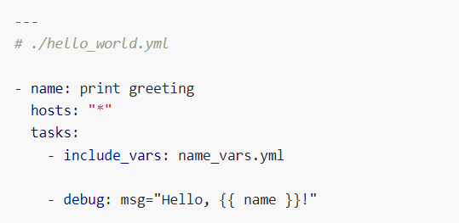
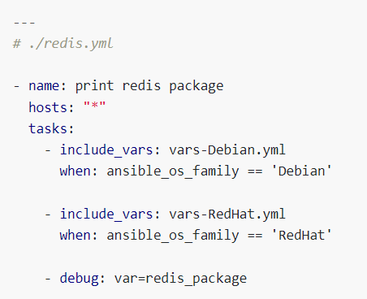
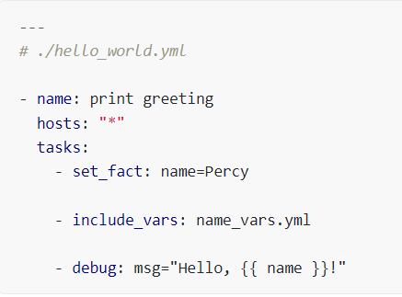
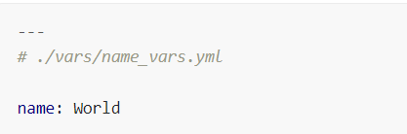
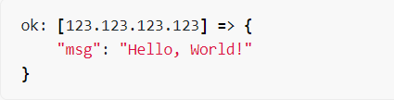
Inventory File & Grouping Variables
Use include_vars
Use include_vars based on condition
Use include_vars priority of variable

Slide 19
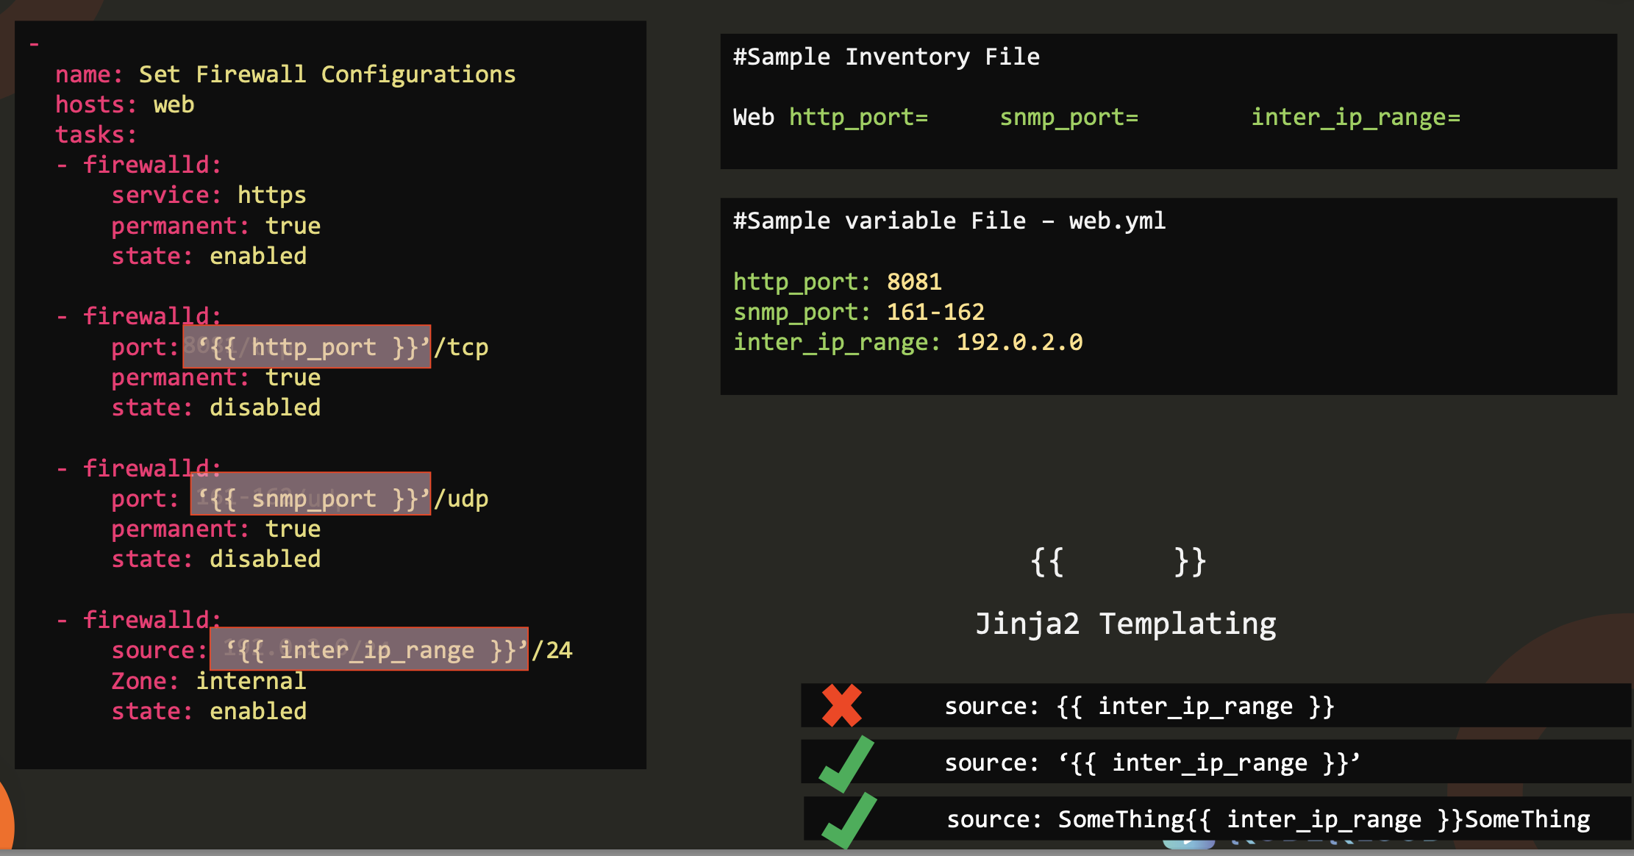

Slide 20
Variables use-cases
Branch: class/ansible-varibles
Vars: passing vars in playbook
Vars_files: passing variables in file
Extra_vars: passing vars as command line parameter
ansible-playbook -i hosts tomcat.yaml --extra-vars "myHosts=tomcatServers"
Registered variable: shell and command variables

Slide 21
Jinja 2 & Filters
Ansible uses Jinja2 templating to enable dynamic expressions and access to variables and facts.
You can use templating with the template module.
For example, you can create a template for a configuration file, then deploy that configuration file to multiple environments and supply the correct data (IP address, hostname, version) for each environment.
You can also use templating in playbooks directly, by templating task names and more.
You can use all the standard filters and tests included in Jinja2

Slide 22
Return Values
Ansible modules normally return a data structure that can be registered into a variable, or seen directly when output by the ansible program.
Each module can optionally document its own unique return values
Below are few return values common to all modules.
Return Attribute | Purpose
backup_file | For those modules that implement backup=no|yes when manipulating files, a path to the backup file created.
changed | A boolean indicating if the task had to make changes to the target or delegated host.
failed | A boolean that indicates if the task was failed or not.
rc | Some modules execute command line utilities or are geared for executing commands directly (raw, shell, command, and so on), this field contains ‘return code’ of these utilities.
results | If this key exists, it indicates that a loop was present for the task and that it contains a list of the normal module ‘result’ per item.
https://docs.ansible.com/ansible/latest/reference_appendices/common_return_values.html

Slide 23
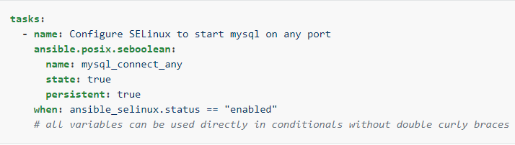
Return Values
In a playbook, you may want to execute different tasks, or have different goals, depending on the value of a fact (data about the remote system), a variable, or the result of a previous task.
You may want the value of some variables to depend on the value of other variables.
Or you may want to create additional groups of hosts based on whether the hosts match other criteria.
You can do all of these things with conditionals.
Basic Conditions Using When

Slide 24
Ansible – Playbook – Sample files used in class
Example of simple modules in ansible
https://github.com/IBT-learning/ansible-playbooks.git

